Slide 1
Azure Migrate

Slide 2
Azure Migrate – Domain Objectives
What is Azure Migrate
Integrated Tools
On-Premises Discovery & Assessment
Server Migration
Data Migration Assistant
Database Migration Assistant
Azure Database Migration Service
Web App Migration Assistant & App Containerization
Azure Data Box & Related Use Cases

Slide 3

Azure Migrate
Service that helps you migrate from an on-premises environment to the cloud.
Azure Migrate helps you manage the assessment and migration of your on-premises datacenter to Azure
Unified migration platform
Range of integrated and standalone tools
Assessment and migration
Notes:
https://docs.microsoft.com/learn/modules/describe-azure-storage-services/6-identify-azure-data-migration-options

Slide 4
Azure Migrate – Integrated Tools
Azure Migrate: Discovery and assessment. Discover and assess on-premises servers running on VMware, Hyper-V, and physical servers in preparation for migration to Azure.
Azure Migrate: Server Migration. Migrate VMware VMs, Hyper-V VMs, physical servers, other virtualized servers, and public cloud VMs to Azure.
Data Migration Assistant. Data Migration Assistant is a stand-alone tool to assess SQL Servers. It helps pinpoint potential problems blocking migration. It identifies unsupported features, new features that can benefit you after migration, and the right path for database migration.
Azure Database Migration Service. Migrate on-premises databases to Azure VMs running SQL Server, Azure SQL Database, or SQL Managed Instances.
Web app migration assistant. Azure App Service Migration Assistant is a standalone tool to assess on-premises websites for migration to Azure App Service. Use Migration Assistant to migrate .NET and PHP web apps to Azure.
Azure Data Box. Use Azure Data Box products to move large amounts of offline data to Azure.

Slide 5
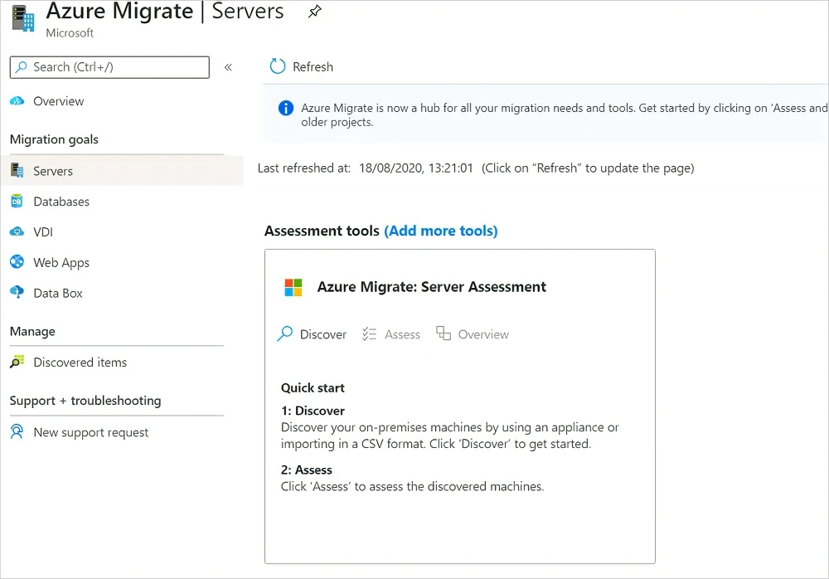
Azure Migrate – Discovery & Assessment
Set up an Azure account with proper Azure & Azure AD permissions.
Prepare physical servers for discovery.
Create a project in Azure Portal.
Set up the Azure Migrate appliance.
Start continuous discovery.
Notes:
Discover physical servers with Azure Migrate Discovery and assessment - Azure Migrate | Microsoft Learn

Slide 6
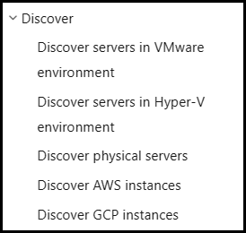
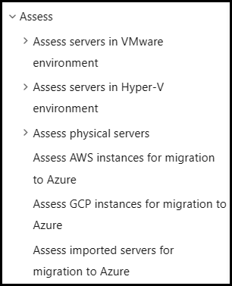
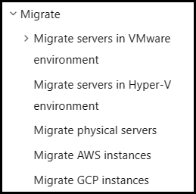
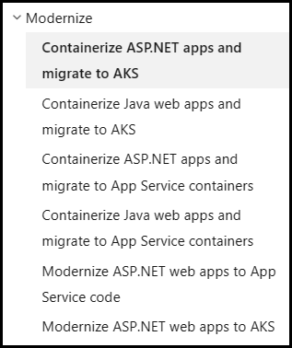
Azure Migrate – Migration Approach & Scenarios

Slide 7
Azure Migrate: App Containerization
The Azure Migrate: App Containerization tool helps you to:
Discover your application: The tool remotely connects to the application servers running your ASP.NET application and discovers the application components. The tool creates a Dockerfile that can be used to create a container image for the application.
Build the container image: You can inspect and further customize the Dockerfile as per your application requirements and use that to build your application container image. The application container image is pushed to an Azure Container Registry you specify.
Deploy to Azure Kubernetes Service: The tool then generates the Kubernetes resource definition YAML files needed to deploy the containerized application to your Azure Kubernetes Service cluster. You can customize the YAML files and use them to deploy the application on AKS.
Notes:
Azure App Containerization ASP.NET; Containerization and migration of ASP.NET applications to Azure Kubernetes. - Azure Migrate | Microsoft Learn

Slide 8

Azure Data Box
Ideally suited to transfer data sizes larger than 40 TBs in scenarios with no to limited network connectivity. The data movement can be one-time, periodic, or an initial bulk data transfer followed by periodic transfers.
Store up to 80 terabytes of data.
Move your disaster recovery backups to Azure.
Protect your data in a rugged case during transit.
Migrate data out of Azure for compliance or regulatory needs.
Migrate data to Azure from remote locations with limited or no connectivity.
Notes:
https://docs.microsoft.com/learn/modules/describe-azure-storage-services/6-identify-azure-data-migration-options

Slide 9
Azure Data Box – Import & Export Use Cases
Onetime migration - when a large amount of on-premises data is moved to Azure.
Moving a media library from offline tapes into Azure to create an online media library.
Migrating your VM farm, SQL server, and applications to Azure.
Moving historical data to Azure for in-depth analysis and reporting using HDInsight.
Initial bulk transfer - when an initial bulk transfer is done using Data Box (seed) followed by incremental transfers over the network.
Periodic uploads - when large amount of data is generated periodically and needs to be moved to Azure.
Disaster recovery - when a copy of the data from Azure is restored to an on-premises network. In a typical disaster recovery scenario, a large amount of Azure data is exported to a Data Box. Microsoft then ships this Data Box, and the data is restored on your premises in a short time.
Security requirements - when you need to be able to export data out of Azure due to government or security requirements.
Migrate back to on-premises or to another cloud service provider - when you want to move all the data back to on-premises, or to another cloud service provider, export data via Data Box to migrate the workloads.

